Slide 1
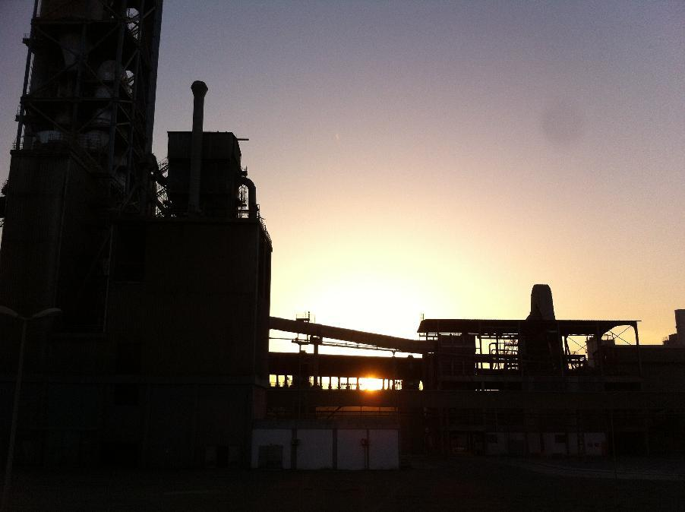
Clinker cooler
Technical Development Program for Process Performance Engineers- SPREAD 2016
Hazem Yousry

Slide 2
Table of Content
Definitions and Theory of Recuperation
Grate Coolers
Operating Principle
Main Elements of Modern Grate Coolers
The Three Golden Rules for Grate Coolers
Facts for Grate Coolers
The Typical Problems of Grate Coolers
2

Slide 3
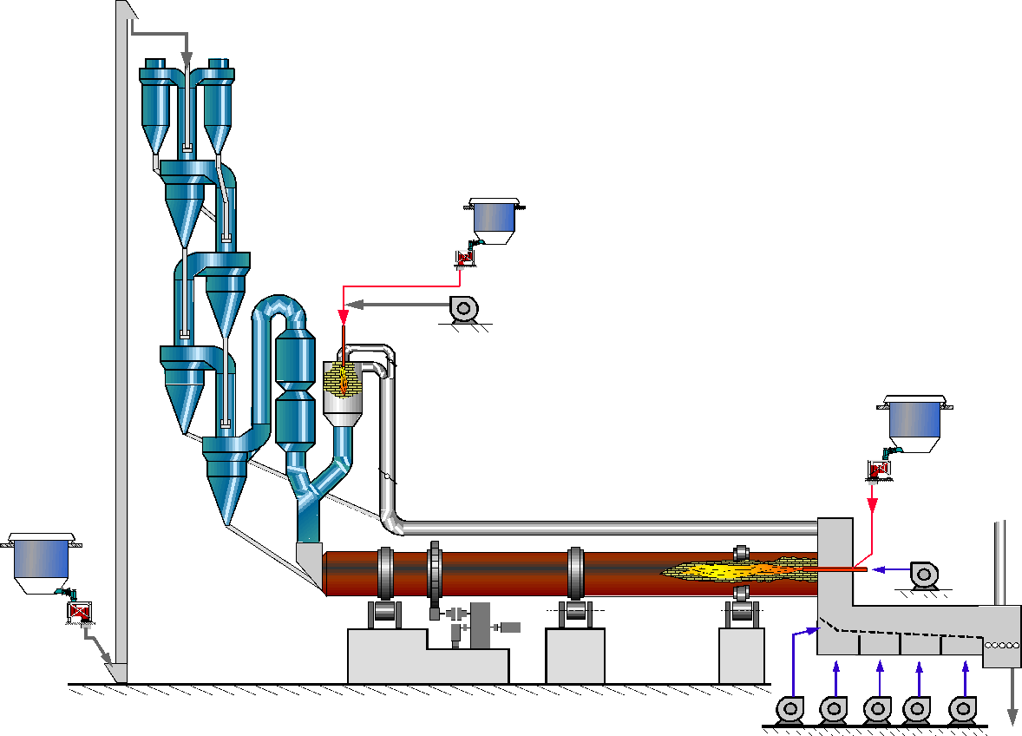
Clinker cooler performance is decisive for pyroprocess!
Clinker
Air
3

Slide 4
Tasks of the Clinker Cooler
1) Recuperation of heat = Return heat from hot clinker back to process
2) Cooling of clinker = Reduce temperature of clinker
Approach to achieve this:
Hot clinker is exposed to a stream of cold air for a certain period of time (= residence time)
The generated hot air is used for combustion or material drying
The clinker is conveyed at a controlled speed
The cooler is tight for clinker and air
4

Slide 5
Definitions
Recuperation is the recovery of heat contained in the hot clinker (1300 to 1450°C) at the kiln discharge that is returned to the kiln system to be used for the pyro process.
Combustion air is the total air required for stoichiometric combustion of the fuels in the kiln and the precalciner; i.e. = primary + secondary + tertiary air
Waste air of (grate) clinker coolers is the cooling air that is in excess of the combustion air and is blown to ambient (via dedusting system). The only purpose of this air is to further cool down the clinker. The heat of this air may be used for material drying or for electricity generation (WHR)

Slide 6
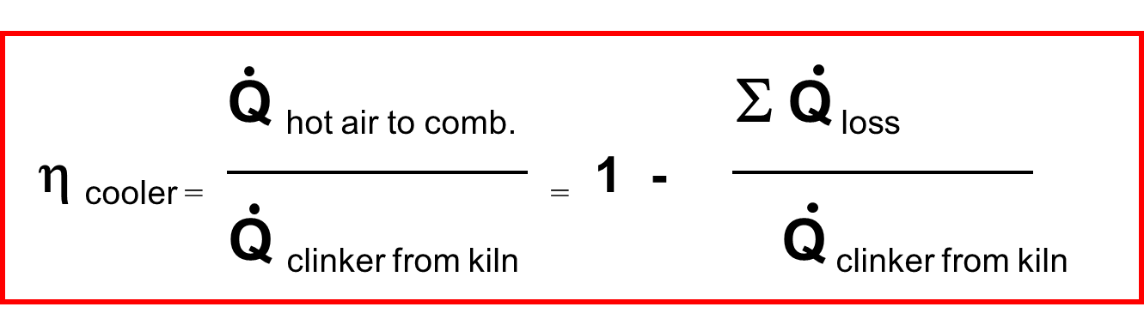
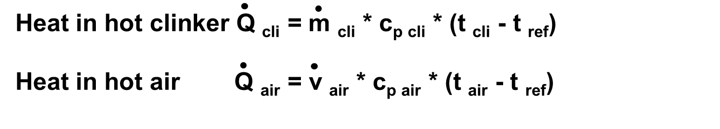
Cooler Recuperation Efficiency η _{cooler}
Important: Because the amount of recuperated heat depends on the air flow for combustion, an η _{cooler} is only meaningful, if the system heat consumption is known!
6

Slide 7
How to Improve Recuperation Efficiency
Factors influencing recuperation efficiency:
Air flow for combustion (secondary and tertiary air) → determined by system fuel requirement + excess air
Temperature of sec & tert air → determined by heat exchange in recuperation zone
Clinker temperature from kiln → determined by process; difficult to measure; ~1450°C
Conclusion: Our efforts must focus on achieving the highest possible combustion air temperatures by optimizing the heat exchange in the recuperation zone!
7

Slide 8
Cooling Principle in Grate Coolers
Hot combustion air to kiln system
Hot waste air to filter
Hot clinker in
Slightly negative pressure!
Grate
Positive pressure!
Cooled clinker out
8

Slide 9
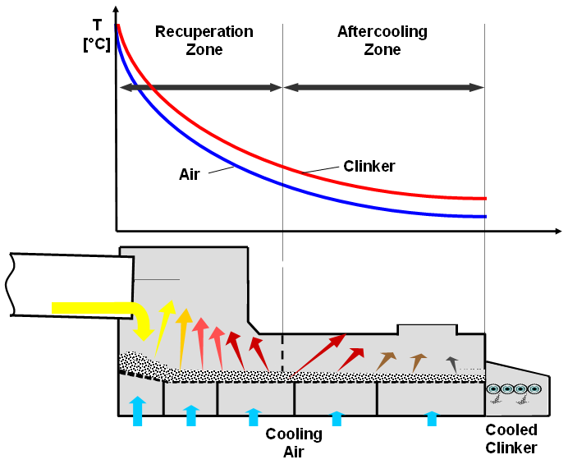
Cooling Curve
9

Slide 10
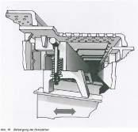
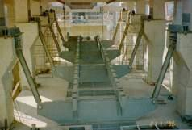
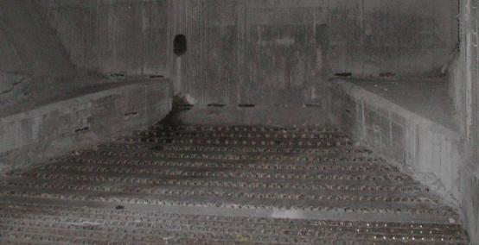
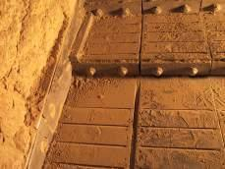
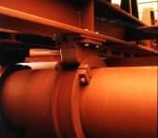
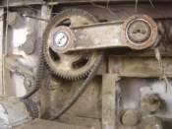
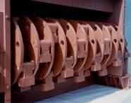
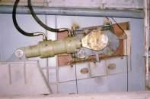
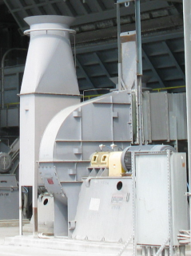
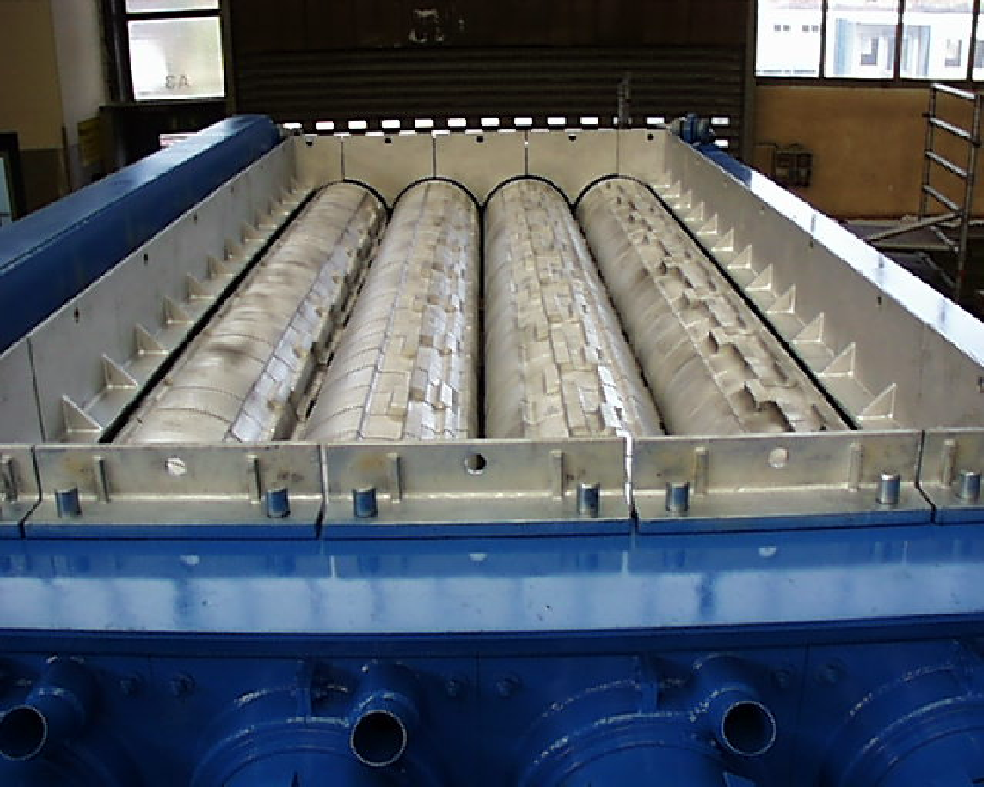
The Main Elements of Grate Coolers
Grate Plates
Grate Support
Static Inlet
Grate Drive
Cooler Fans
Clinker Crusher
Casing

Slide 11
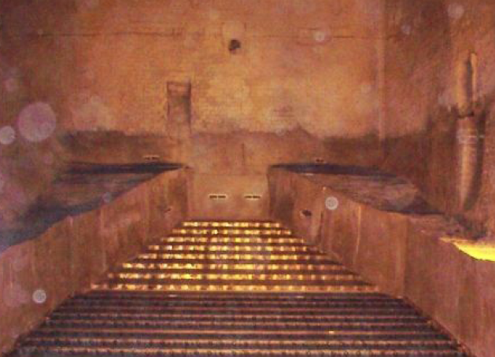
The Static Cooler Inlet: Typical Main Features
Air blasters (snowman!)
No moving rows
14°-15° inclined grate line
5 – 8° inclined plate surface
Refractory horseshoe
Direct aeration
Minimum 2 aeration zones 1 or 2 fans
11

Slide 12
Static Cooler Inlet
Advantages:
Rapid initial clinker cooling to avoid clinker agglomeration
Better clinker distribution from the drop point to the entire grate width
Static (dead) clinker layer on the grate plates → Reduced thermal exposure of the grate surface and supporting structure → no burnt plates → better availability
No moving parts in impact and high temperature zone
100% sealed (no air losses)
Is standard for all new coolers
Proven good possibility to upgrade older grate coolers!
12

Slide 13
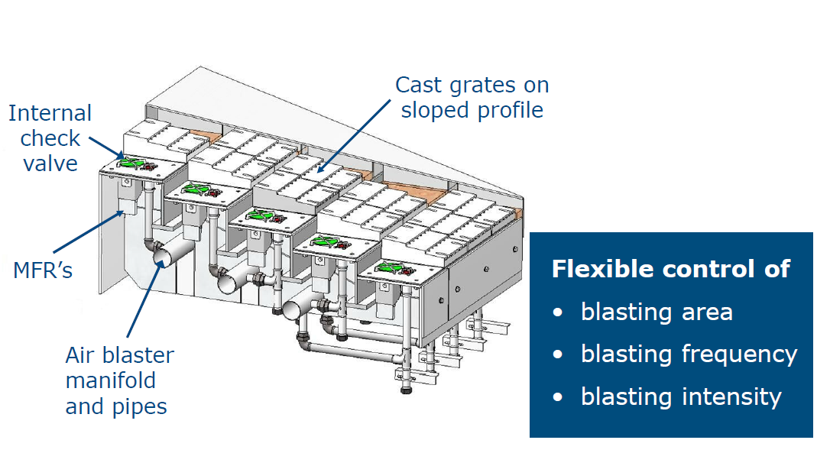
Example: FLSmidth New ABC (Air Blast Control) Inlet
13

Slide 14
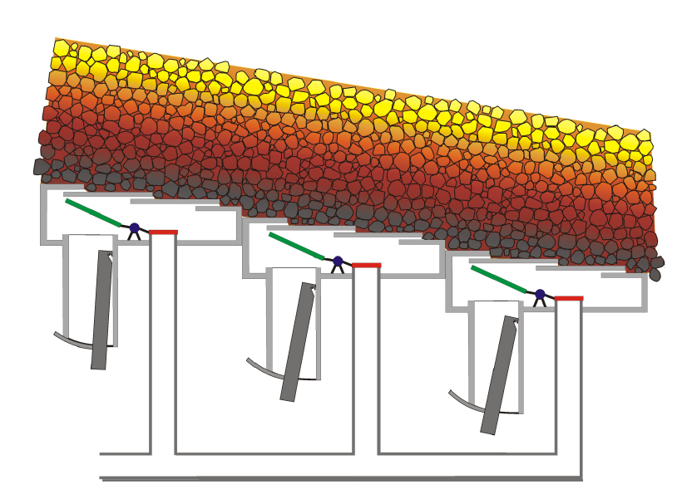
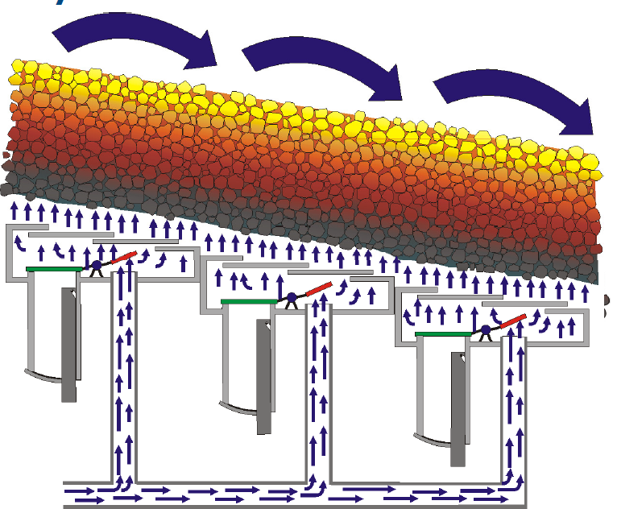
ABC Inlet: Air blast through normal aeration slots
Normal operation: Cooling air from fans to chamber through flow regulator and aeration slots into clinker
Blast operation: Air from blaster replaces cooling air, and passes through aeration slots into clinker
14

Slide 15
The Three Golden Rules of Clinker Cooling
Keep the clinker on the grates (minimize fall through) ➔ improve gap management
Controlled air distribution into the clinker (fan volume control, minimize air losses)
Operate with low grate speed (high clinker bed); even clinker distribution required
➔ Increased cooler efficiency and cooler availability
15

Slide 16
Key to Optimum Grate Cooler Performance
Operate at the highest possible bed depth, i.e. 600 – 1000 mm, depending on clinker granulometry
This requires
Even clinker bed depth across grate width
Sufficient installed fan delivery pressure
No air escaping through gaps
Between plates
Between grate plate rows
Grate plates and wall
Between undergrate compartments
TIGHT !!
16

Slide 17
Fact 1:There is Clinker Segregation at Kiln Discharge
Kiln Rotation
Offset
Fine clinker
Coarse clinker
17

Slide 18
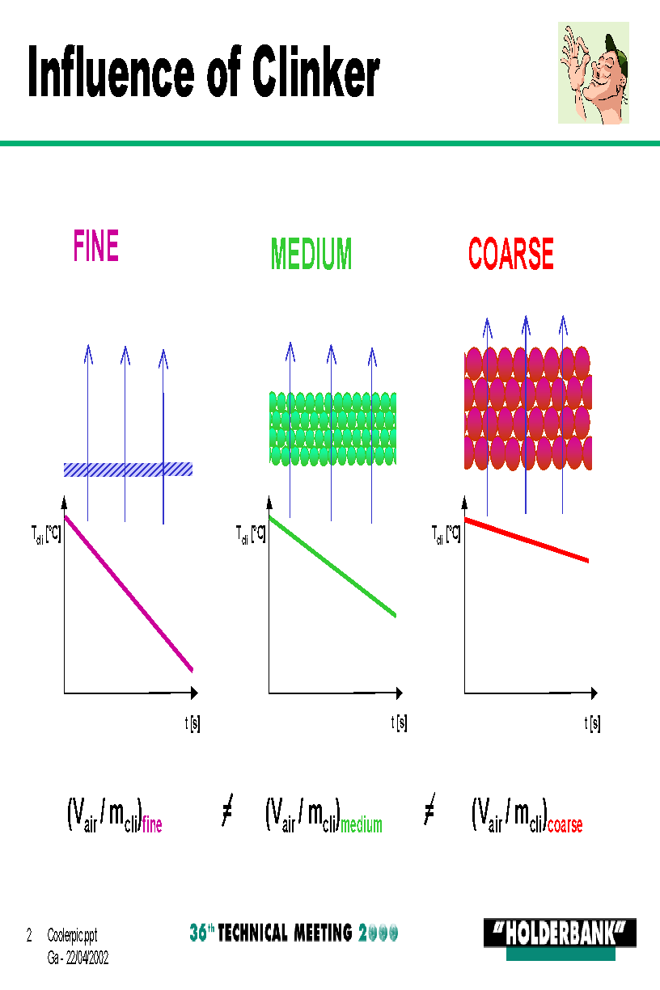
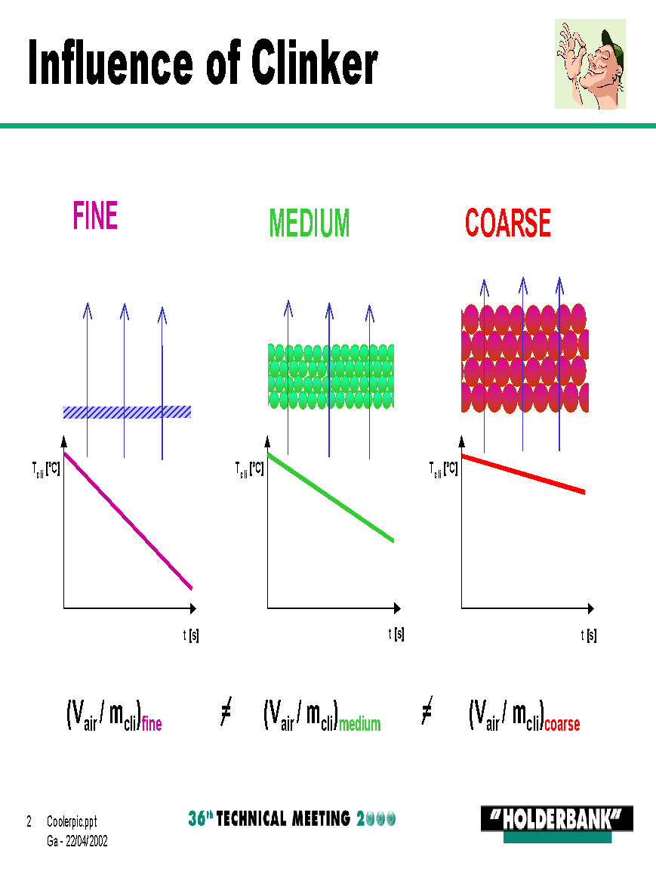
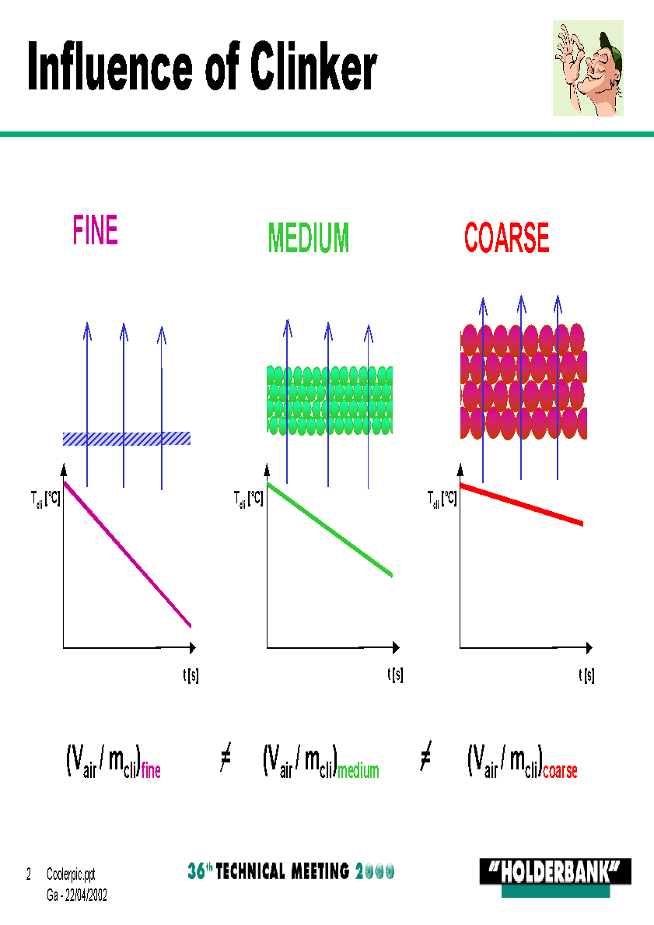
Fact 2:Resistance and cooling depend on clinker size
Faster cooling due to > Higher specific surface > Hot core closer to surface
Slower cooling due to > Lower specific surface > Hot core away from surface

Slide 19
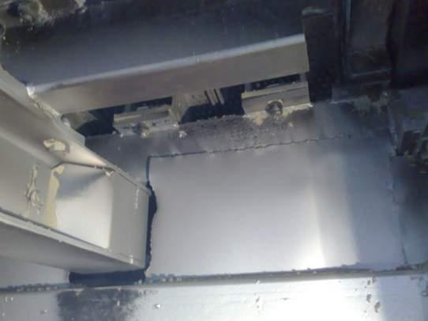
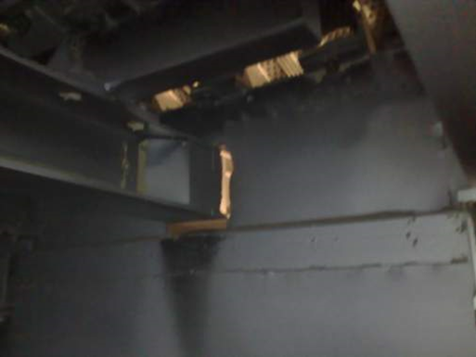
Excellent Compartment Sealing is Key
“Light check” reveals holes in partition wall !!!
19

Slide 20
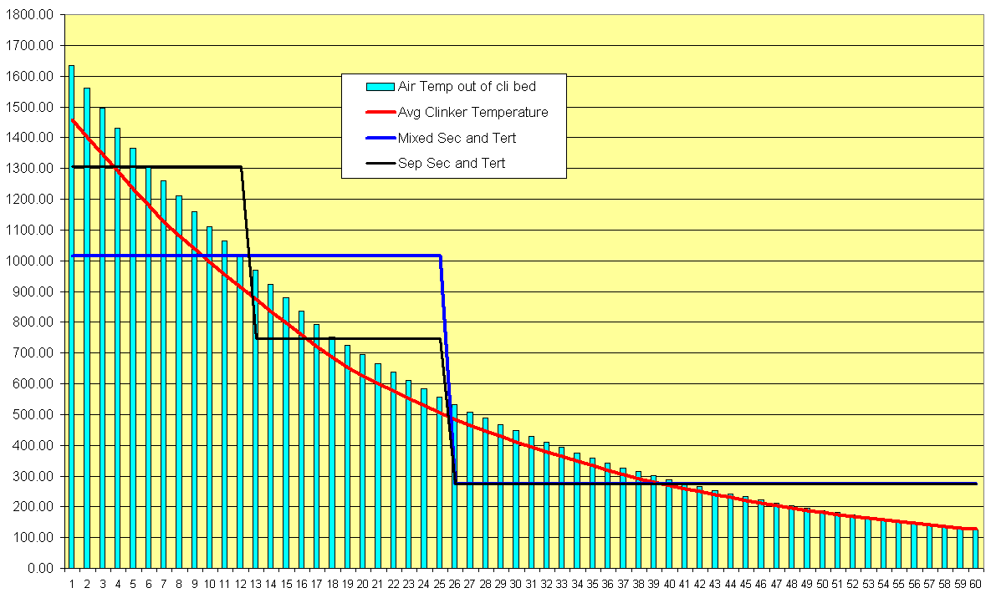
Fact 3: Influence of Hood or Roof Extraction on Tertiary Air Temperature
780°C
1000°C
280°C
1300°C
1000°C
Recuperation Zone
20

Slide 21
Typical Problems of Grate Coolers
Thin bed
Geyser (air blow-through)
Fritting / caking
Red river
Snow-man
Poor UG seal
Burnt plates
High fall through
Dust leakage
21

Slide 22
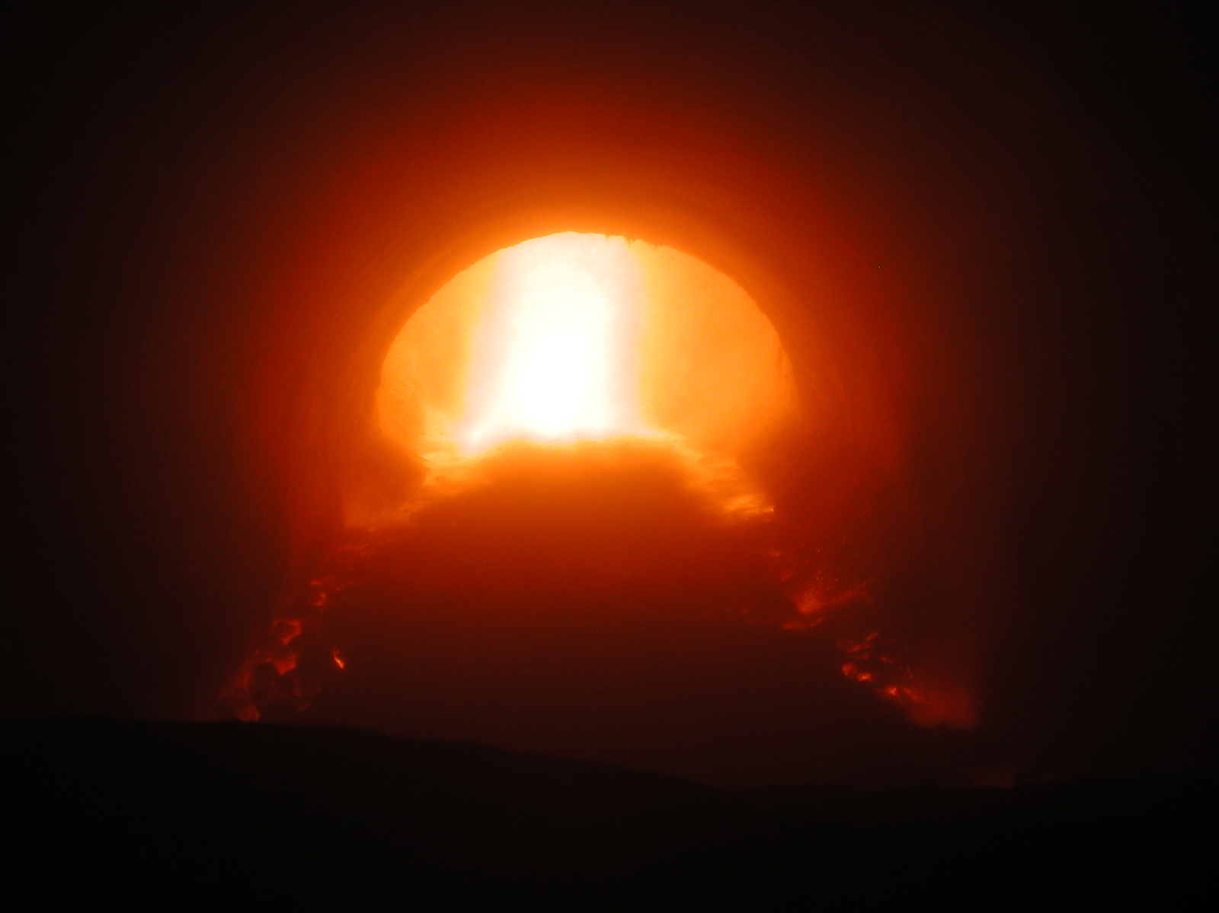
Red River
A Red River is fine clinker fluidized by cooling air on top of and on one or both sides of the clinker bed (like airslide).
Travelling faster than the clinker bed, it has less retention time, is hotter than the clinker below and radiates on top of black clinker.
Effect:
Damage on grate side seal
Reduced heat exchange
22

Slide 23
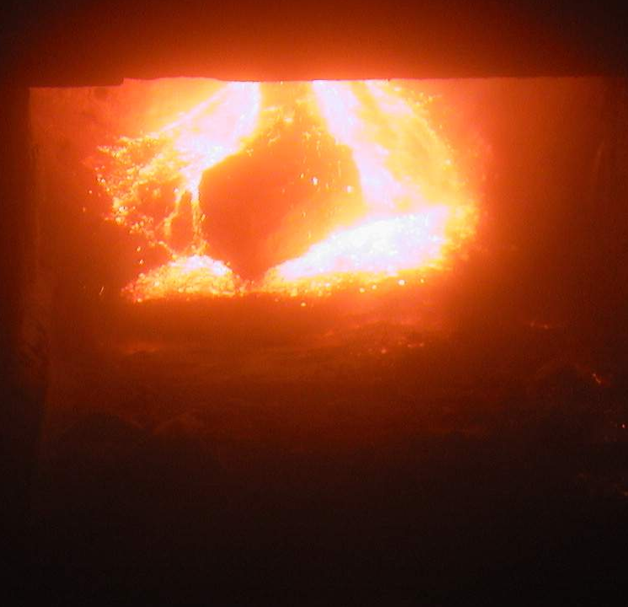
Snowman
A snowman starts when hot clinker sticks to the cooler, often in the in the drop area, and the following clinker keeps piling up.
If not removed in time (by air blaster e.g.) the snowman can reach the kiln nose ring and must be manually removed. → 1 – 2 days kiln stop!
Effect:
Disturbed clinker distribution
Kiln stop (see above)
23

Slide 24
Holcim Dimensioning Rules for Grate Coolers
Installed cooling air: >= 2.0 Nm³/kg_{cli} *
Grate size / specific loading <= 40 t/(m²d) *
First fan pressure: >=100 mbar
Grate width load: 1080 [t/(m d)] + Cli prod [t/d] x 0.08 [m⁻¹] range: + / - 150 t/d * → see graph on next slide * Standard Design Criteria 2012
→ >0.9* Nm³/(s m²)
If the cooler is designed according to the above rules, the following operating parameter can be expected:
Grate speed* 10 to 15 strokes/min
Clinker temperature ~90 + t ambient
Recuperation Efficiency >70 % (at 3’100 kJ/kg) * traditional reciprocating grate
24

Slide 25
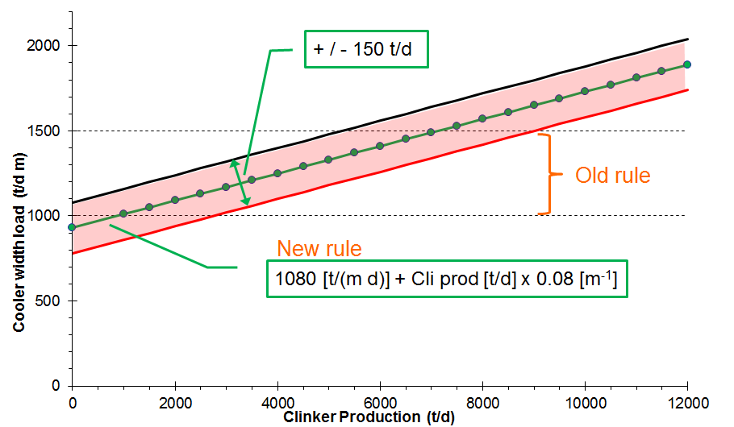
Grate Width Load and Kiln Production
25

Slide 26
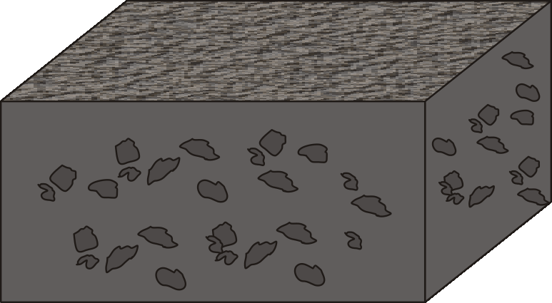
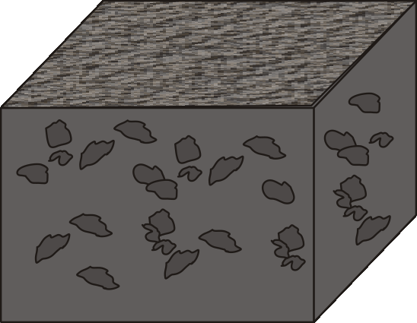
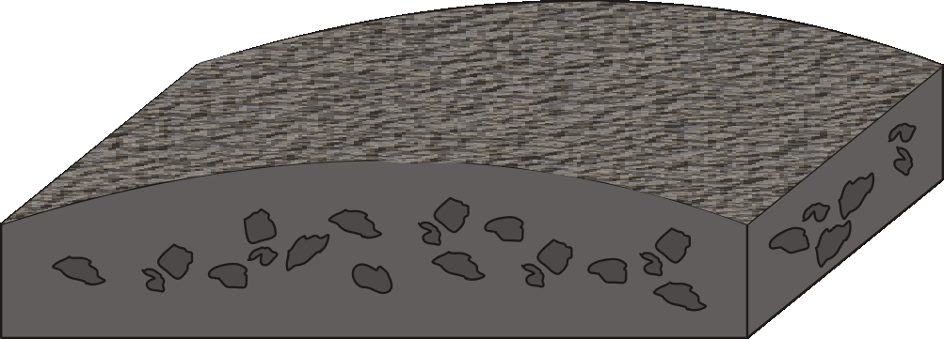
Significance of Grate Width Load
<<1000 t/d m (grate too wide)
1000 - 1500 t/d m (grate width ok)
>> 1500 t/d m (grate too narrow)
Bad distribution across grate width → uneven aeration → poor heat exchange → too low grate speed
High grate speed to maintain throughput → Excessive wear!
26

Slide 27
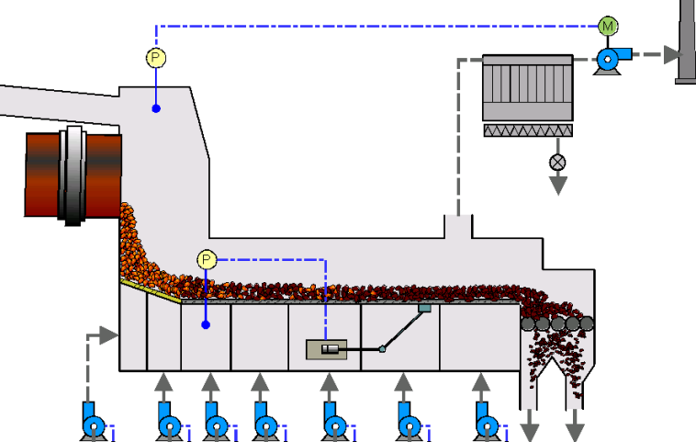
Main Control Loops for Grate Cooler
Kiln hood pressure control
Clinker bed height control
Cooling air volume control
V
V
V
V
V
V
V
27

Slide 28
Clinker Bed Depth
Low clinker bed (< 500 mm) Limited air retention time in clinker Short clinker retention time in cooler Short cooling time Low heat transfer Risk of grate plate overheating High clinker exit temperature Low secondary air temperature Limited heat recuperation and efficiency Frequent equipment overheating High clinker temperature | High clinker bed (> 600 mm) Higher air retention time in clinker Long clinker retention time in cooler Increased cooling time Improved heat transfer Best protection for grate plates Lower clinker exit temperature Higher secondary air temperature Increased heat recuperation and efficiency Increased cooler availability Low clinker temperature
28

Slide 29
Measures to Fight Snowman Formation
General
Change raw mix for lower liquid phase
Move burner deeper in kiln → lower clinker temperature at cooler inlet
Static Inlet
Optimize “horse shoe” of static cooler inlet
Optimize air blaster nozzles location
through cooler walls
from within grate (Polysius & FLS)
Air blaster operation (sequence)
Increase specific aeration of cooler inlet
Manual removal of snowman
29

